Slide 1

Pre-Order Workflow in ERP
(Updated as on 18-12-2018)

Slide 2
Purpose
The module will enable –
  Release of Technical Specification from Engineering for procurement
  Getting technical offer from Vendor till placement of LOI

Slide 3
Table of Index
Sequence of Steps | Slide No
1. Engineering releases Technical Specification to Buyer | 1,2,3
2. Buyer sends Enquiry to Vendor for the Technical Specification received from Engineering | 4,5,6
3. Vendor Submits technical offer through link sent on e-Mail | 7,8
4. Buyer reviews the Technical Offer submitted by Vendor and Generate IDMS Receipt | 9, 10,11,12
5. Engineering submits consolidated comments against Technical Offer submitted in IDMS | 13,14
6. Buyer sends consolidated comments to Vendor using the Notes functionality | 15,16
7. Once the offer vetting cycle is complete, Buyer will invite Commercial Offer by using Notes functionality( New Page ‘Techno Commercial Negotiation For Enquiry Completed*’) | 17,18*,19
8. In response to above Note from buyer the vendor will upload commercial offer through Enquiry Response form(by accessing the link provided in Mail) | 19
10. Buyer downloads commercial offer and mark the Enquiry as Commercial Offer Received | 20
11. Once offer comparison and negotiation is completed, LOI is finalized and the same is communicated to Vendor using Notes functionality. | 21
12. Buyer will change the Enquiry status as Commercial Offer Finalized | 22
13. Change Buyer and/or Project Manager | 23
14. Pre Order Project Details | 24

Slide 4
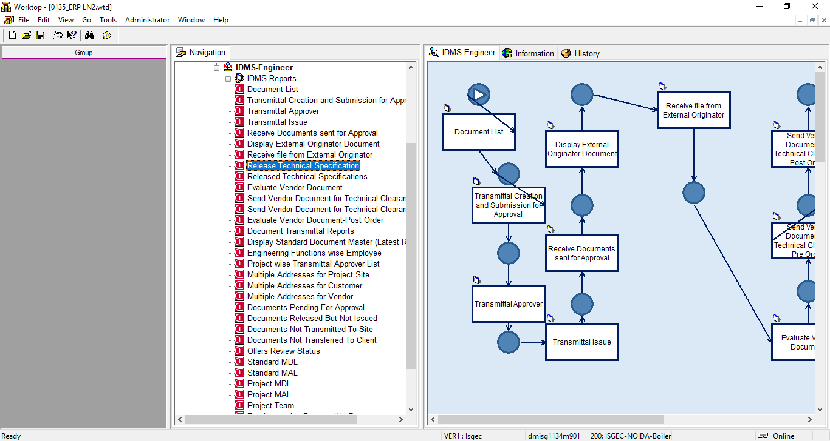
1. Engineering Menu

Slide 5
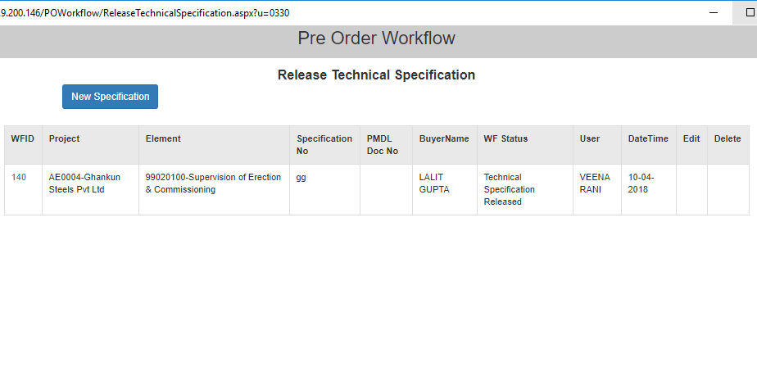
2. Engineering - Release Technical Specification
Use this link to resend the returned Specification from Material
Use this link to release new Technical Specification
Engineering can check status of all Released Technical Specifications here

Slide 6
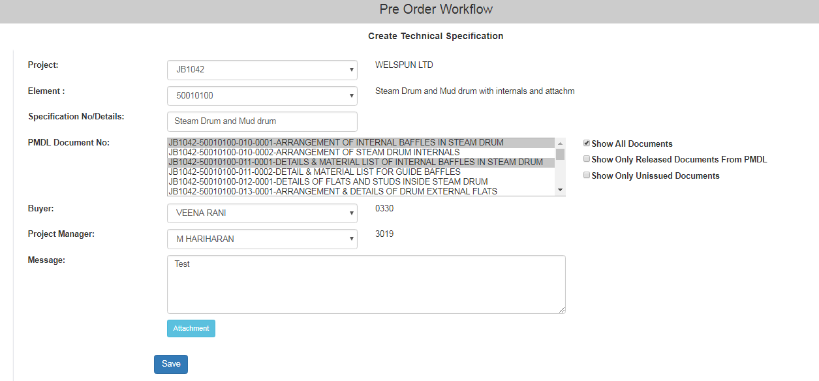
3. Engineering - Release Technical Specification
Select Project/ element
Enter Specification Detail
Select one or more PMDL Document No. from dropdown(new)
Select Buyer
Select Manger(New)
In Message notes can be written which will be sent as mail alert to buyer.
Attach Specification file, the Tech. Spec. released through transmittal will be visible for selection
Save data , An email alert will be sent to Buyer, Manger

Slide 7
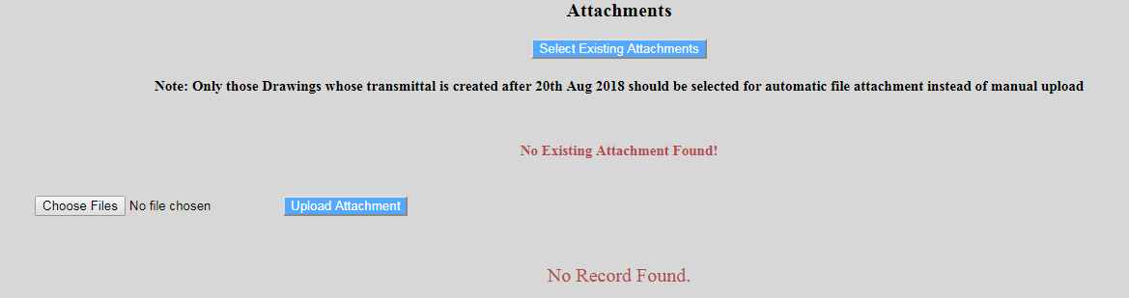
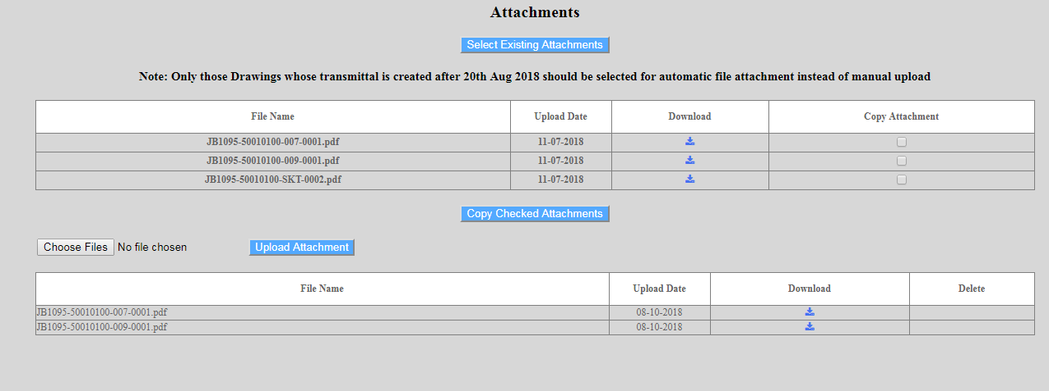
Attachment

Slide 8
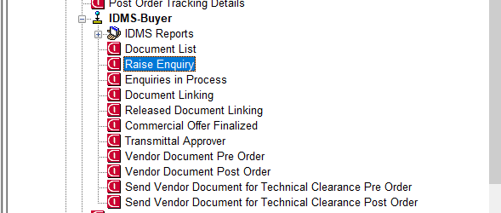
4. Materials Menu

Slide 9
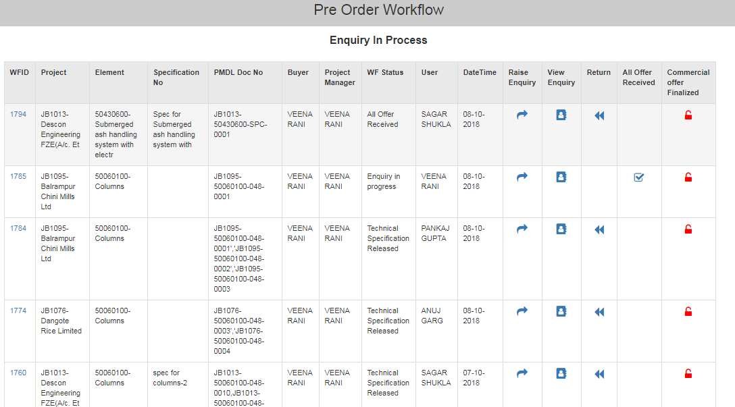
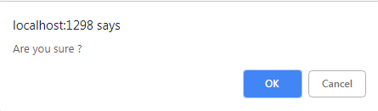
5. Materials - Raise Enquiry
Use this link button to indicate that no further offers are required i.e. All Offers are received.
When user clicks on this button a confirmation Pop-up box appears to let user confirm whether he really wants that no further offers are to be received.
Upon confirmation by clicking on ‘OK’ button status of work flow changes to ‘All Offer Received’
Use this link to return the Enquiry, Status becomes ‘Technical Specification Released Returned’ and buyer can resubmit it again
Use this link to raise Enquiry to vendor

Slide 10
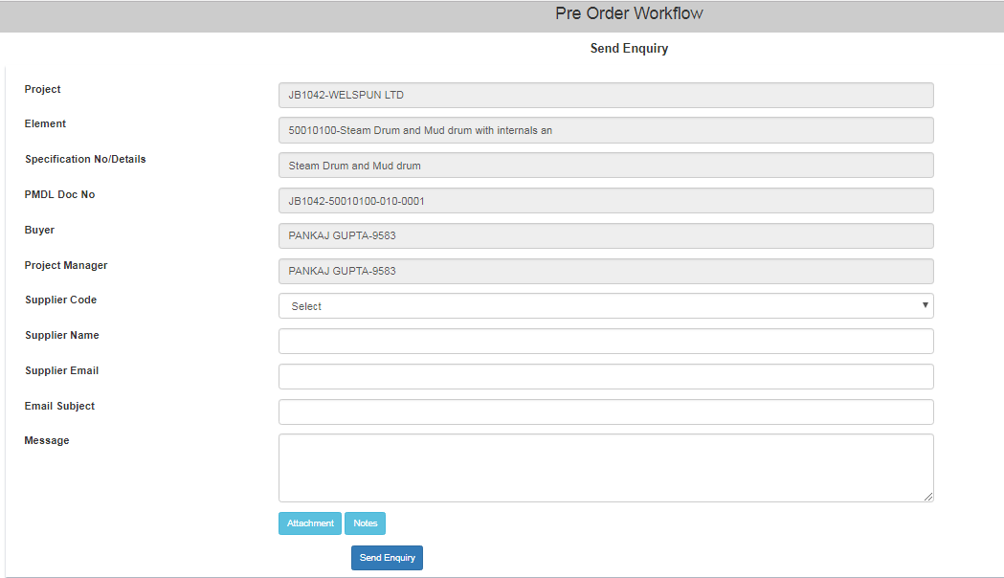

6. Materials - Send Enquiry to Supplier
Enter Supplier Code, Supplier Name, Supplier Email ID
Type content in Message which will be sent as email to supplier
Add any additional file if you want
Click Send Enquiry
User can now select Supplier Code from dropdown by typing Supplier’s name

Slide 11
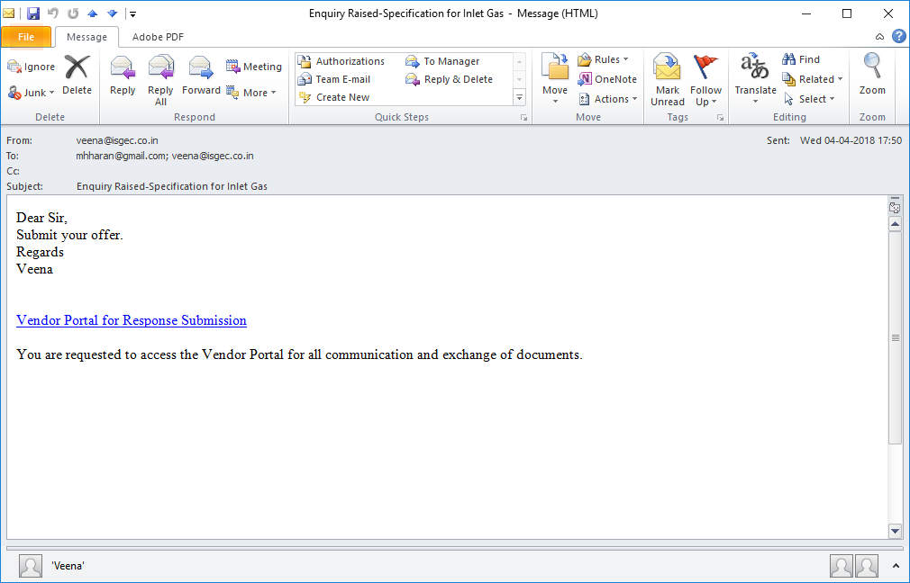
7. Email Alert to Supplier for raised Enquiry
Supplier receives mail on Send Enquiry
Supplier clicks the link – Vendor Portal for Response Submission

Slide 12
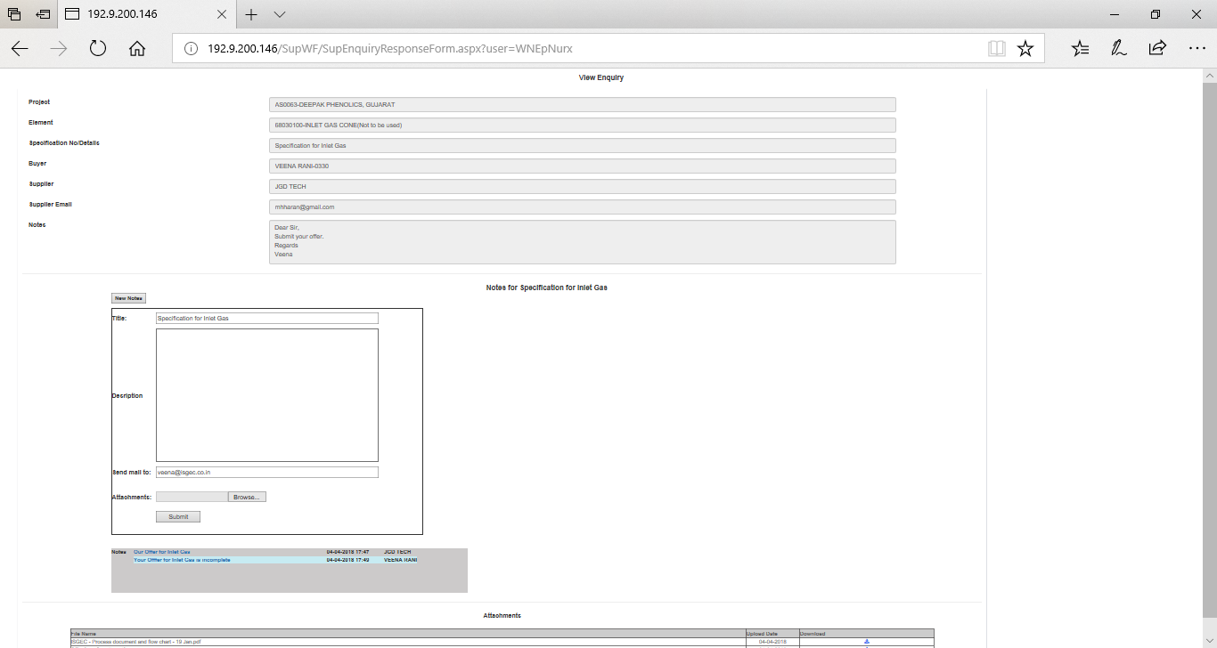
8. Supplier portal for response of Enquiry
On this page supplier can –
Down load the Technical specification
Do communication with buyer through notes

Slide 13
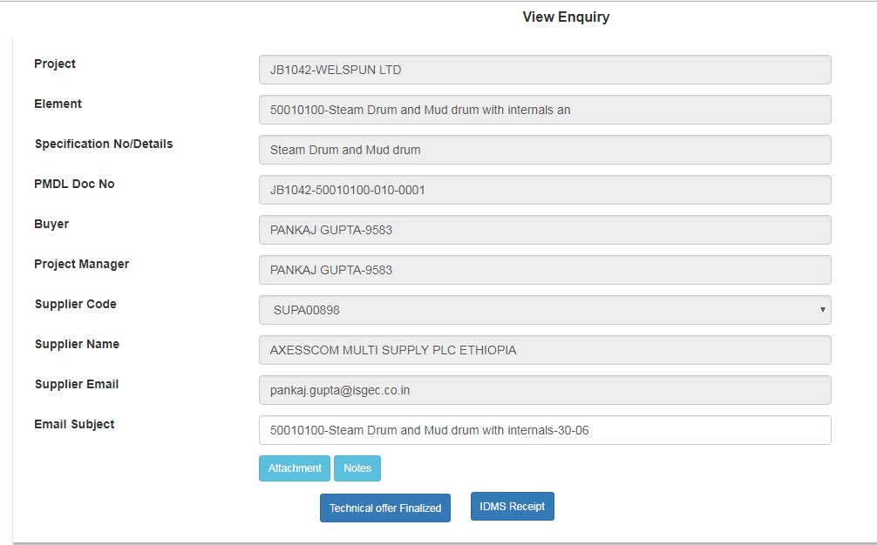
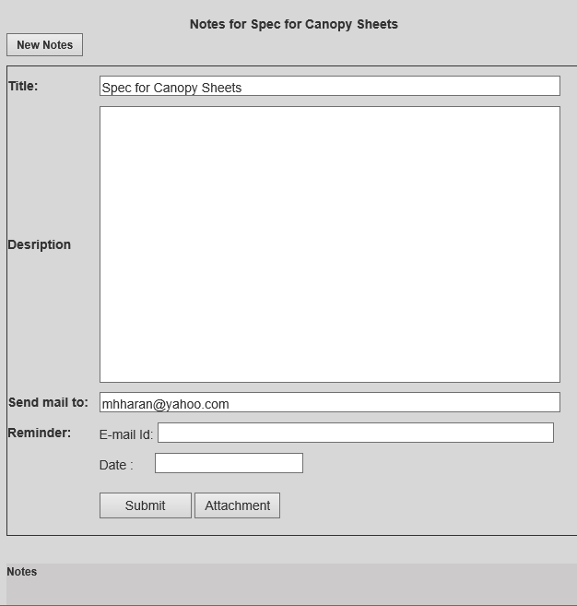

9. Materials - Receive Technical Offer
1. Use this option to exchange Notes with Supplier
2. All notes generated by Buyer or supplier will be visible at single screen along with attachments(if any)
Supplier will send technical offer to buyer through notes attachment

Slide 14
9. Materials - Receive Technical Offer
1. Use this option to exchange Notes with Supplier
2. All notes generated by Buyer or supplier will be visible at single screen along with attachments(if any)
Supplier will send technical offer to buyer through notes attachment

Slide 15
9. Materials - Receive Technical Offer
1. Use this option to exchange Notes with Supplier
2. All notes generated by Buyer or supplier will be visible at single screen along with attachments(if any)
Supplier will send technical offer to buyer through notes attachment

Slide 16
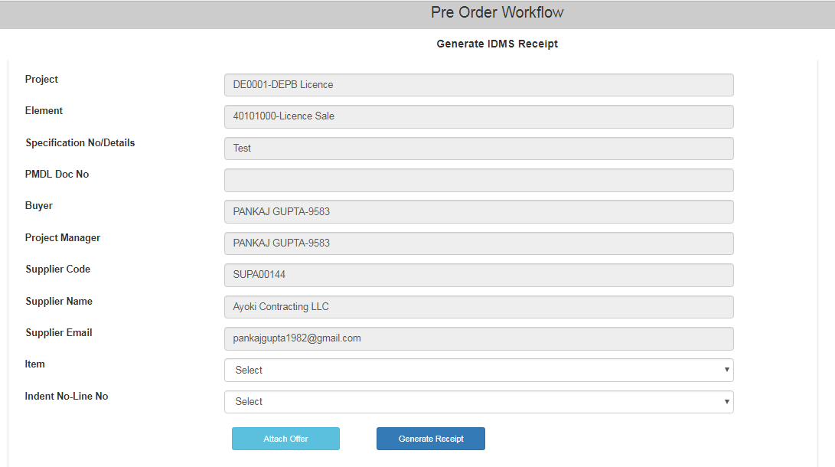
10. Generate IDMS Receipt
After Selecting Item No. and Indent No. Click this button to Generate IDMS Receipt

Slide 17
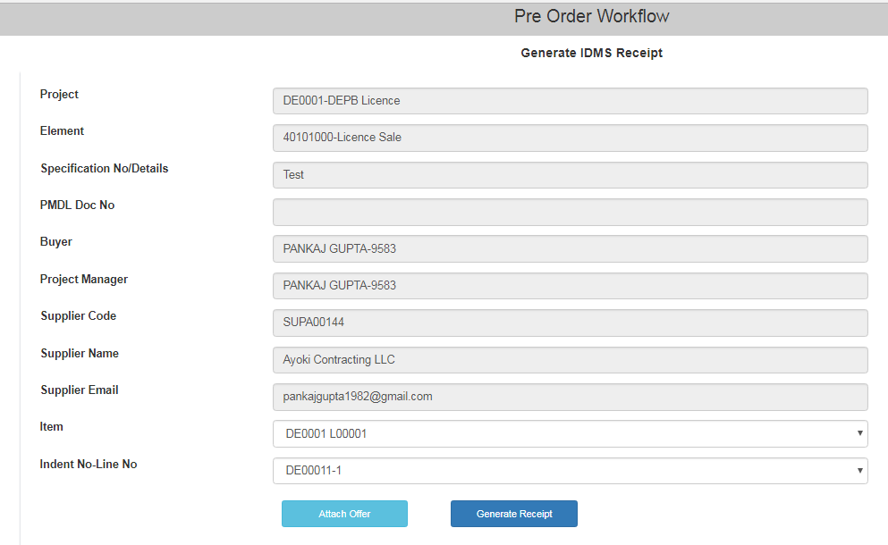
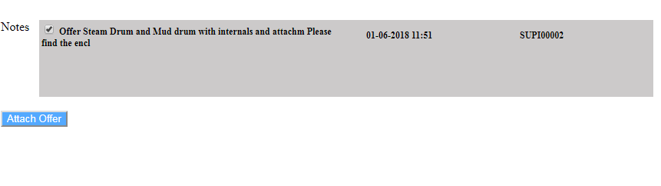
11.Generate IDMS Receipt contd..
After selecting Item Code, Click this button to Attach offer sent by supplier (offer sent by supplier through notes will be visible here, no need to download document on local system)

Slide 18

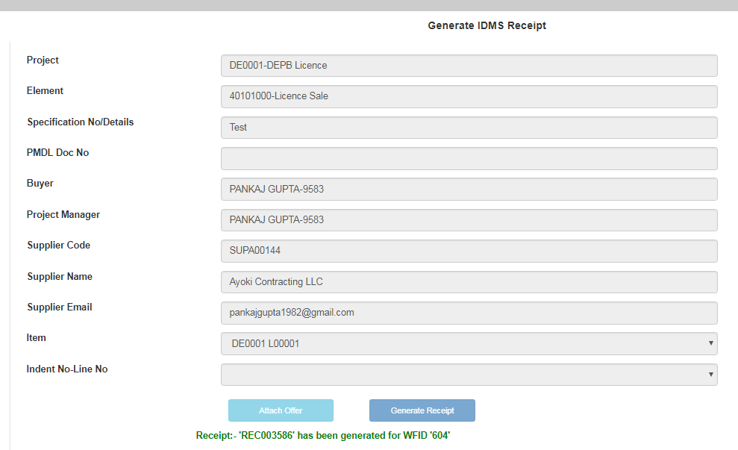
12.Generate IDMS Receipt contd..
Click on this button to Generate IDMS Receipt. Upon successful generation a confirmation message with Receipt Number will be shown.

Slide 19
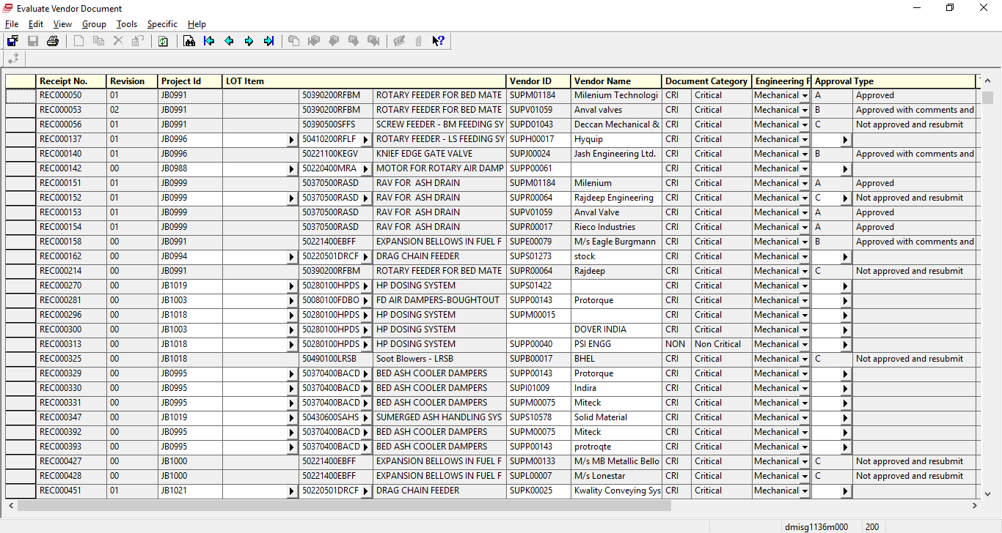
13. Engineering submits comments against Technical Offer

Slide 20
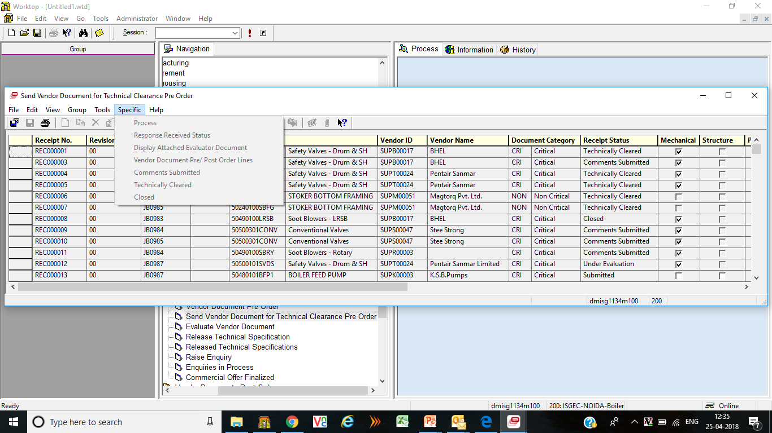
14. Engineering submits comments against Technical Offer

Slide 21
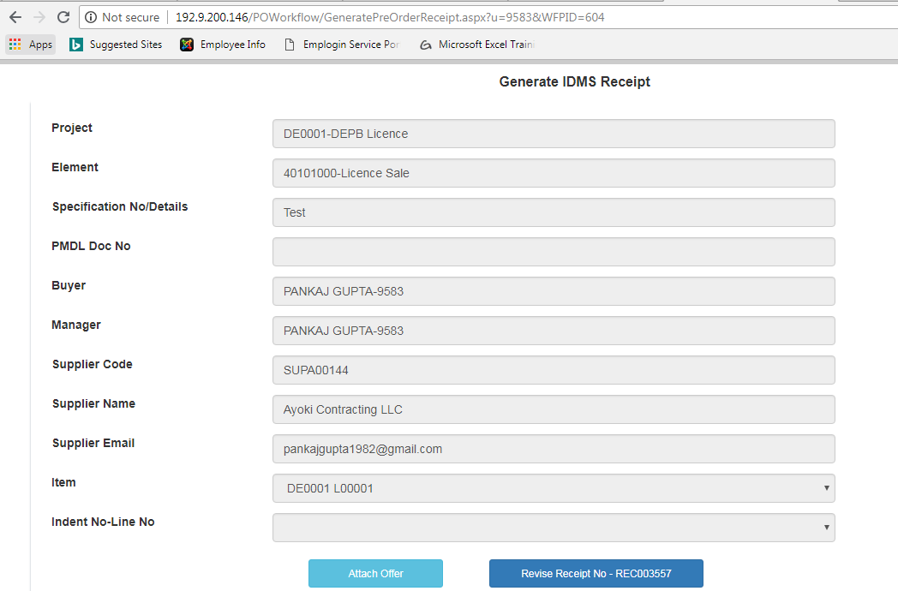
15.Generate IDMS Receipt contd..
(Revise Receipt No)
On clicking ‘Attach Offer’, user will be able to see new revised attachment
If latest revision of receipt is in ‘Comment Submitted’ status , then user will be able to revise the receipt by clicking on ‘Revise Receipt- RECXXXXXX’ button.
(For all other statuses this button will be disabled) After this latest revision status is changed to ‘Superseded’

Slide 22
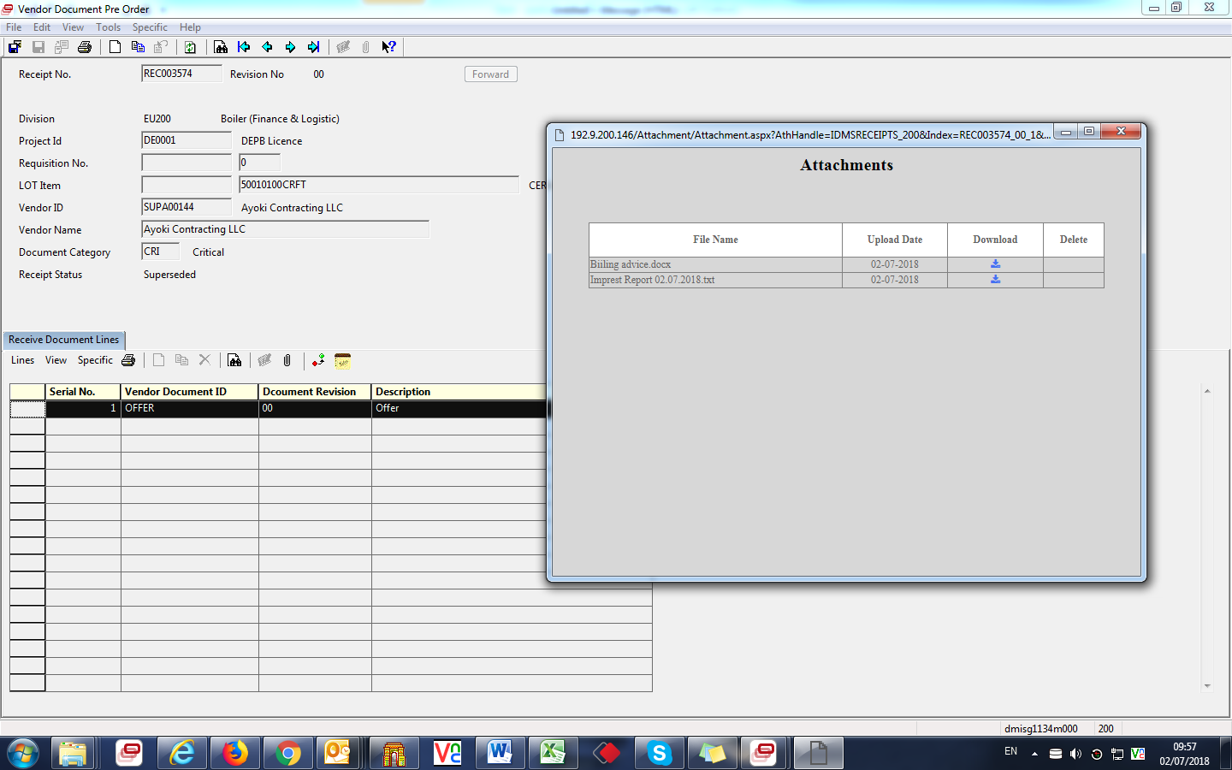
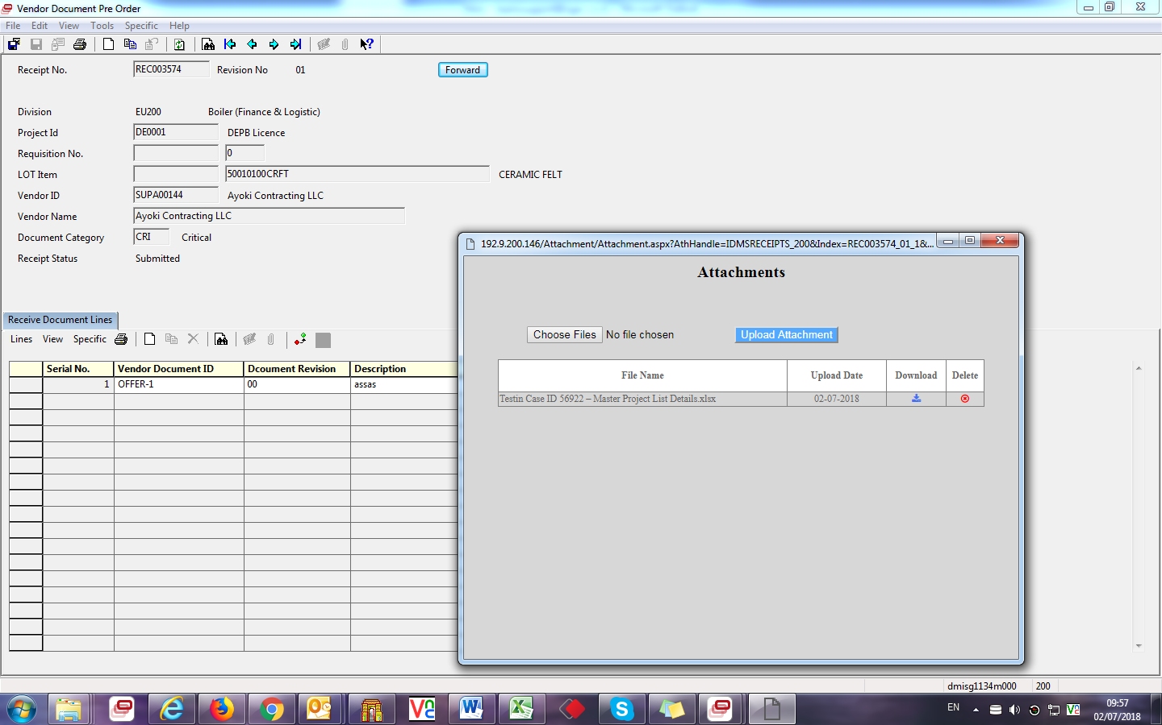
Attachments With Revised Receipt
Attachment for Receipt having Revision ‘00’ and Revised Revision ‘01’ .

Slide 23
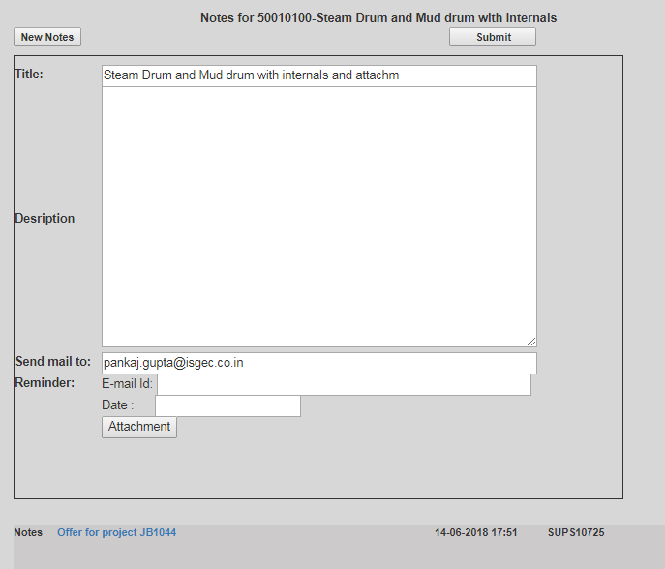
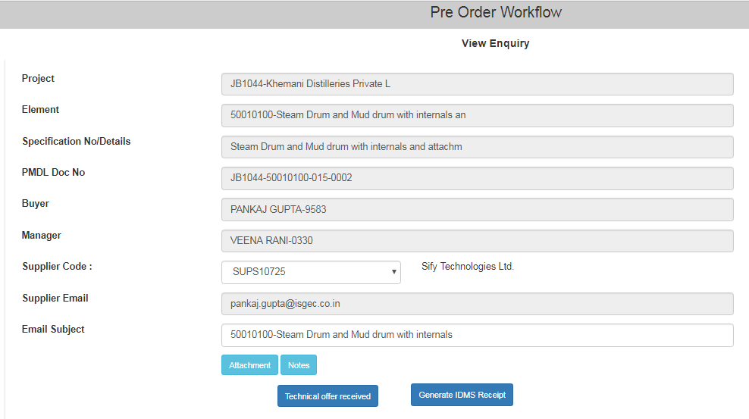

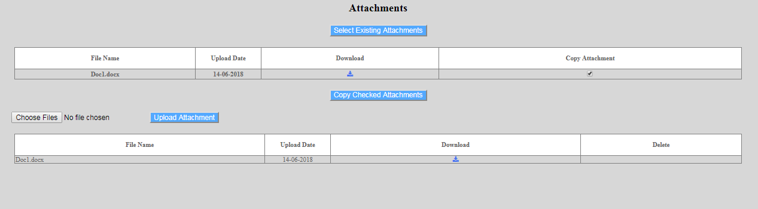
15. Materials – Forward comments to Supplier
1. When Engineering submits comments , buyer will get an email notification
2. Buyer can forward the comments to supplier using the notes functionality
3. The relevant document will be available for selection in the notes attachment module.

Slide 24
16. Materials – Repeat steps 8 to 15
Repeat Steps 8 to 15 till Technical offer is Finalised.

Slide 25
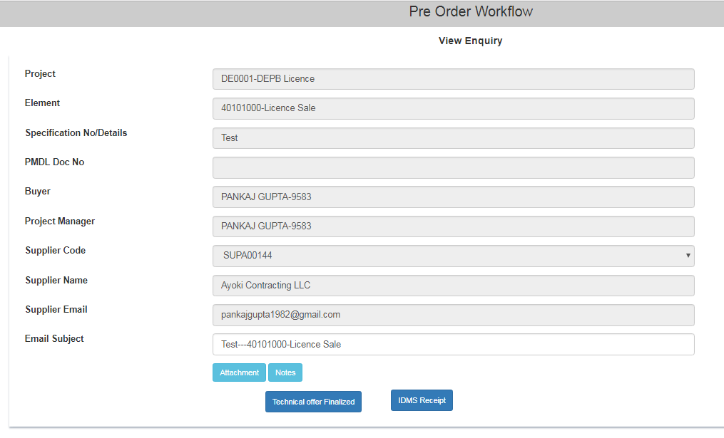
17. Material – Final Technical offer Received
Once the Technical offer among all suppliers is finalised, click this button
It will update 100% Technical vetting progress of this RFQ in Control Tower.
It is possible that Enquiry is sent to 5 suppliers but technical offer is finalized after vetting documents of 3 suppliers, in such scenario buyer will click this button after vetting 3 offers and control tower will consider 100% Technical vetting progress of this RFQ

Slide 26
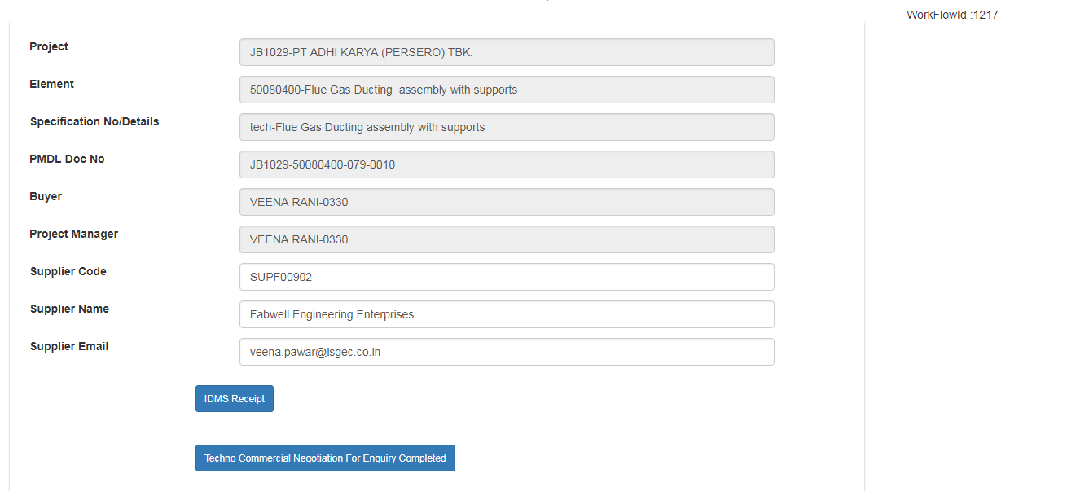
18.Techno Commercial Negotiation
For Enquiry Completed
Once the Techno Commercial Negotiation is completed and final offer is accepted among all suppliers, click this button.
It will update 100% commercial negotiation progress of this RFQ in Control Tower.
It is possible that Enquiry is sent to 5 suppliers but commercial negotiation is finalised after negotiation with 3 suppliers , in such scenario buyer will click this button after negotiation with 3 suppliers and control tower will consider 100% commercial negotiation progress of this RFQ

Slide 27
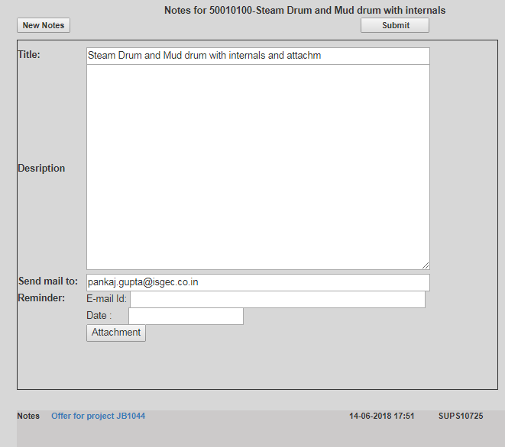
19. Materials – Invite Commercial Offer
Use Notes functionality to invite commercial offer from supplier

Slide 28
20. Supplier – Upload Commercial Offer
Supplier will upload commercial offer through Enquiry Response form(by accessing the link provided in Mail)

Slide 29
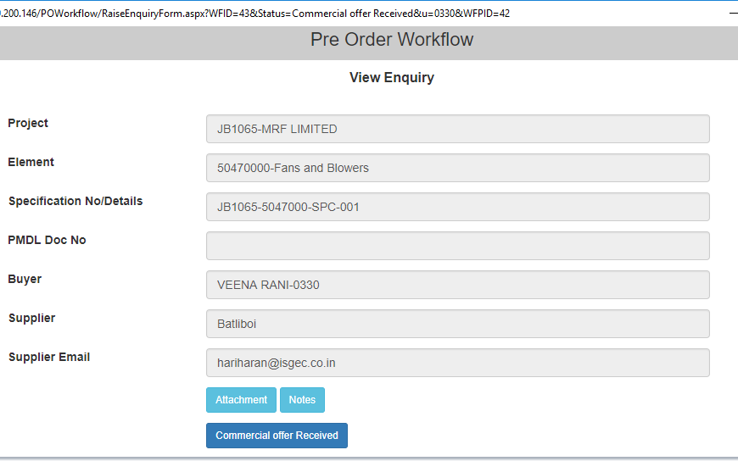
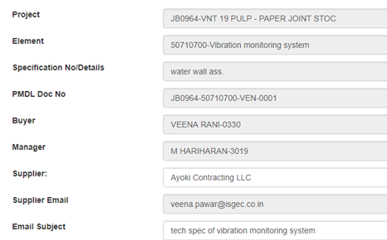
21. Receive Commercial Offer
Use Notes functionality see commercial offer from supplier

Slide 30
23. Commercial Offer Finalized

Slide 31
End of Document

